Slide 1
Welcome!
Please grab your syllabus, the paper folded in half, and your favorite color marker
Find your name on the desk
Create a name plate on the paper folded in half based on this example:
Top left corner:
What do you want to be
remembered for doing or for being?
Top right corner:
Favorite food
Name
(please write it big so I can see it from the front)
Bottom left corner:
Hobby or something you like doing
Bottom right corner:
Favorite place in the world

Slide 2
Agenda and Announcements
Agenda
I’ll introduce myself
Take a look at the syllabus
Look at my website
Set up Remind
Textbook
Ordeal by check
Age of Exploration
Columbus and sourcing
Personal History
Announcements
No announcements yet

Slide 3
APUSH
Introductions and European Exploration

Slide 4
Ms. C…
My 3rd year at Independence and 7th year teaching
I’m a twin
Graduated from Virginia Tech with a Bachelor of Arts history degree and Masters in Education/Curriculum
I moved 8 times by the time I turned 18

Slide 5
Let’s take a look at the syllabus
My contact information
AP exam date
Goals of the Course
Grading
Extra Credit
Classroom Expectations
Materials----please have by September 6/7
Late work

Slide 6
Website
ihscostantini@cms.k12.nc.us

Slide 7
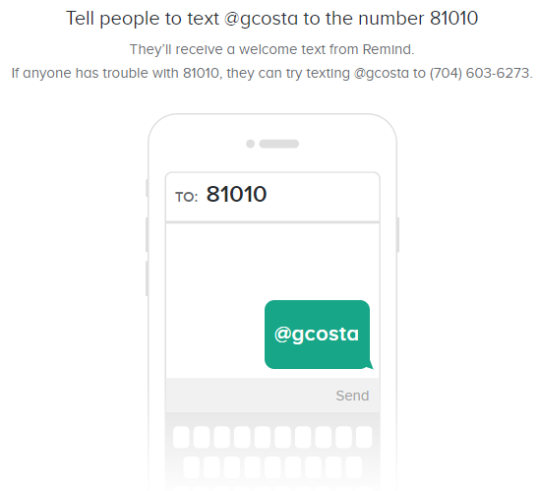
Remind---2A

Slide 8
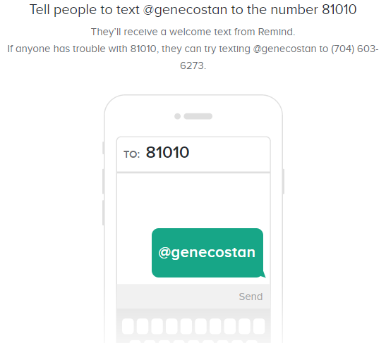
Remind 2B

Slide 9
Textbooks and Calendar
Please:
Grab the textbook
The two sheets of paper on my desk
Textbook contract
Calendar

Slide 10
Ordeal by Cheque
You and your seat mate are going to “do history”
I’ll give you a series of checks written by the Lawrence Exeter Sr and Jr
Create a story using the cheques as evidence
Let’s take a look together at the first 3

Slide 11
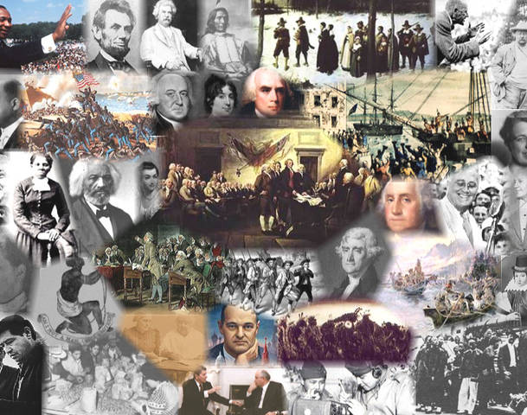
Finally…history content

Slide 12
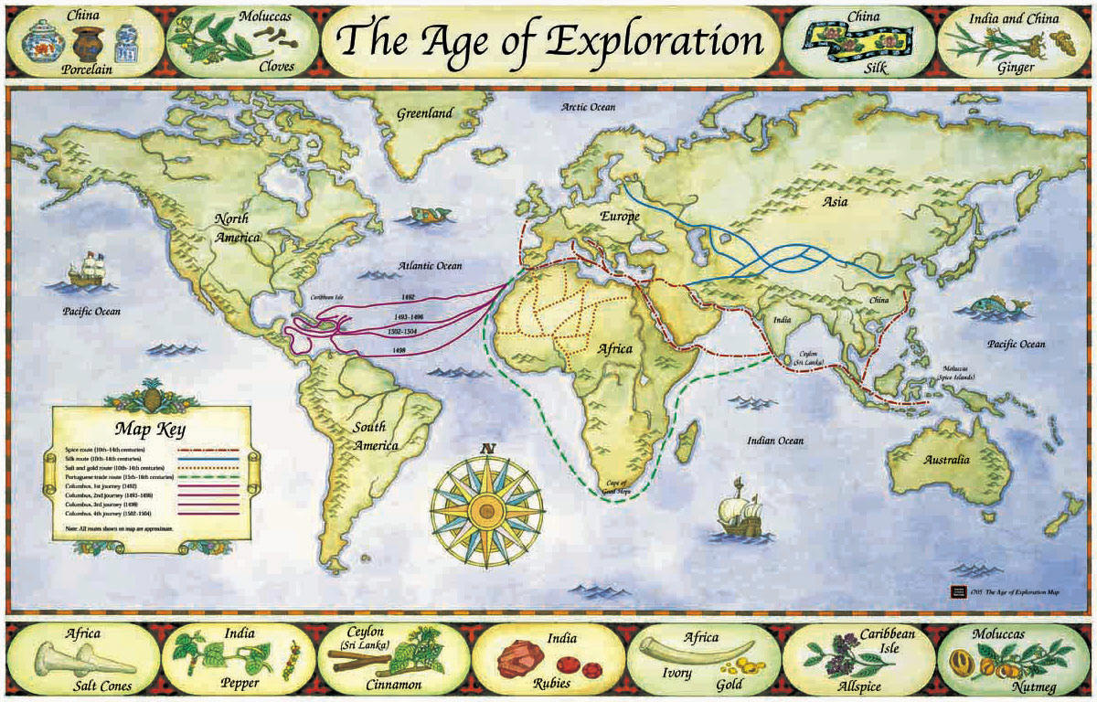

Slide 13
Popcorn reading
We’re going to some reading together and taking notes together
So, the rules for when we do popcorn reading:
I’ll ask someone to read the first paragraph or two
After they’re done, they’ll pick whoever they want to read
If you don’t know where we are, then you stand until I tell you to sit down
After a paragraph or two, you’ll pick someone else
I might stop and ask you all to jot some notes down or discuss a point

Slide 14
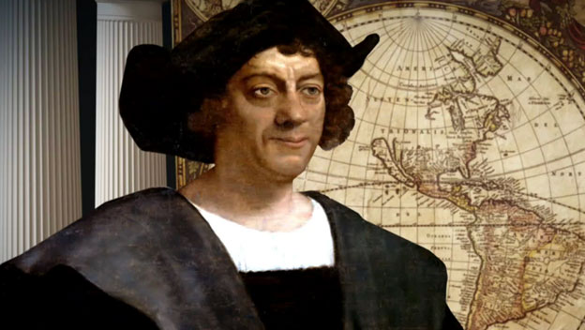
In fourteen hundred and ninety two…

Slide 15
Sourcing the documents
H-historical context
I-intended audience
P-authors purpose
P-point of view

Slide 16
Sourcing the documents
So, you and your partner are going to do a little practice with this Christopher Columbus letter
So take some time to read the document
Make sure to understand the doc
Then create 4 sourcing statements
Remember, you have a sheet AND you have a partner to help
Talking is expected and encouraged in this activity
When you’re done, please put it in the bin on my desk
Grab the sheet from my desk and work on that please

Slide 17
Personal History Project
I’m looking to learn about you.
Pick one of the projects that interests you and follow the project description
If you have a question or a possible alternative project, come talk to me
This is due the day 9/6-7

