Slide 1
Warm Up
Grab the 2 handouts from my desk
One is your ID’s
One is an image and quote
Please work on the image and quote
The quote asks you to analyze manifest destiny
The image asks “what do you see and what do you think it means?”
You may work with your group

Slide 2
Agenda/Announcements
Agenda
Warm Up: Manifest Destiny
Presidents Project Q2
Manifest Destiny
Conflict/Compromise DBQ
Announcements
I’ll be after school Tuesday
Unit 5 Assessment Nov 30/Dec 1--IDs

Slide 3
President’s Project Q2
Due Jan 9/10
6 Presidents this time
James Monroe November 28-29
Andrew Jackson December 4-5
James Polk December12-13
James Buchanan December 18-19
Abraham Lincoln January 3-4
Ulysses Grant January 9-10
Rubrics are made from information from the textbook…so use the textbook

Slide 4
Period 5
Territorial Expansion, Civil War, Reconstruction

Slide 5
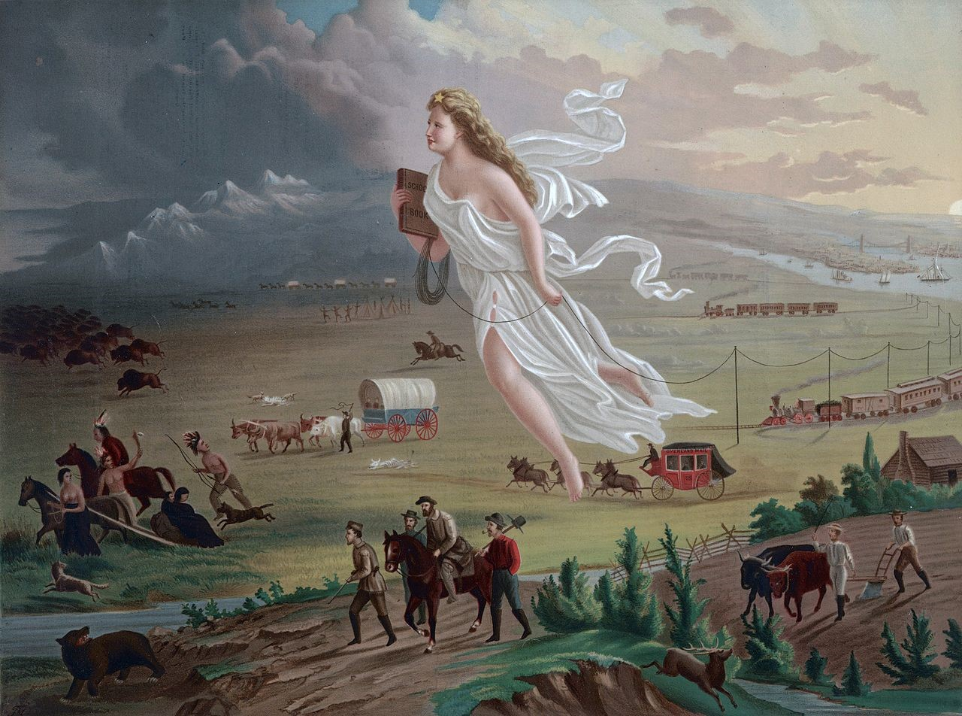

Slide 6
Conflict/Compromise DBQ
DBQ is a type of essay
Let’s look at some guidelines

Slide 7
Let’s look at your prompt

Slide 8
In your groups
What do EACH of the documents mean?

Slide 9
Let’s make a timeline
Pull out a piece of paper (notebook or blank is fine)
What should our bookends be?

Slide 10
Let’s make a timeline
Pull out a piece of paper (notebook or blank is fine)
What should our bookends be?
What’s happening before?

Slide 11
Let’s make a timeline
Pull out a piece of paper (notebook or blank is fine)
What should our bookends be?
What’s happening before?
What’s happening after?

