Slide 1
Warm Up
Grab the sheet from my desk
You and your group are going to read the docs
Complete the chart---you’re looking for changes or continuities (something that stays the same)– look at my example
Complete HIPP (sourcing the docs)

Slide 2
Agenda and Announcements
Agenda
Warm Up: Impact DBQ
Notes: Articles of Confederation and Shay’s Rebellion
Crash Course
Constitution
Announcements
Unit 3 Assessment, ID’s, reading notes, Revolution timeline due October 12/13
Binder check for Units 1, 2, and 3 is October 16/17
Presidents Project due Oct 16/17

Slide 3
Articles of Confederation

Slide 4
Under the Articles
Borrow money
Make treaties
Declare war
Deal with the Indians
Control Western lands
Deal with foreign problems
Run Postal Service
One branch of government: Congress, responsible for making national laws
Each state had one (1) vote in Congress
No executive (President)
No judiciary (Courts)

Slide 5
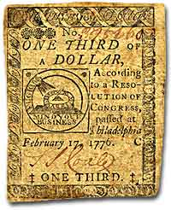
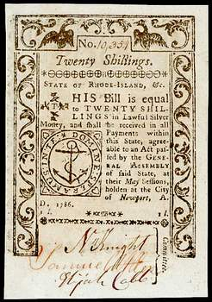
Weaknesses
National government could not collect taxes
The national government had to ask the individual states for money
There were national and state currencies
Each state could regulate trade with other states
Each state could tax its residents
Only the states could establish militias (state militaries
9 of 13 states had to approve a proposal before it could become a law
All the states had to agree to amend the Articles of Confederation

Slide 6
Why were the Articles of Confederation so weak?
What we didn’t like about the British. . .
Taxation without representation
Large central government (monarchy) had all the power
States always had to listen to the king
All power was in the King’s hands.
King could change the system of government any time
So the Articles of Confederation…
Federal government could not tax
States didn’t have to follow laws and treaties.
States had their own laws and didn’t have to follow any other states’ laws
No executive branch or national court system.
Any amendment required all 13 states

Slide 7
It Wasn’t All Bad - Accomplishments
Peace Treaty with Great Britain (treaty of Paris of 1783)
Land Ordinance of 1785 – decided how to systematically cut up the new lands in the Northwest Territory; got large states to give up claims to Western lands.
Northwest Ordinance of 1787– a system which said new states could be added, including prohibiting slavery

Slide 8
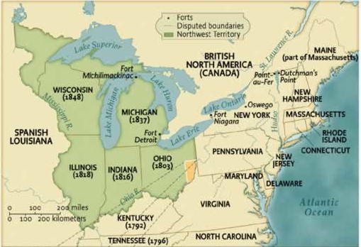
Northwest Ordinance
Provided for the organized creation of the 5 states that today we call OH, IN, MI, IL, WI,

Slide 9
Economy in the 1780s
America suffered a depression during the 1780s.
Huge national and state debts were left from the Revolution.
The excessive use of credit to purchase consumer goods after the war (especially to British merchants) caused debt problems.
A lack of currency plagued the states.
Foreclosures on farms increased as farmers could not pay debts.
Runaway inflation
British companies flooded America with goods at very low prices.

Slide 10
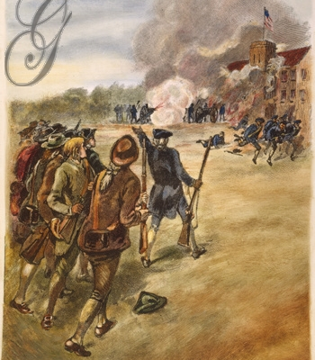
Shay’s Rebellion
Western farmers dealing with high taxes
Massachusetts law - can’t pay taxes = jail, loss of property
Daniel Shay leads men to arsenal for weapons
Federal troops cannot help!
Significance: Shows the weakness of the Articles of Confederation

Slide 11
John Green Crash Course
https://www.youtube.com/watch?v=bO7FQsCcbD8&list=PL8dPuuaLjXtMwmepBjTSG593eG7ObzO7s&index=8&t=70s
Your job-------write down what you can-----adding to what you know about the A of C and the Constitution

Slide 12
Constitutional Convention and Compromises

Slide 13
Writing Framework
I provide the skeleton, you provide the muscle
…meaning you already have the thesis and topic sentence from the DBQ this morning and a list of facts
Your job is to write the 3 body paragraphs with the evidence provided
You do not have to use ALL of the evidence, but you do need to use most of it
Pull out a piece of paper, rewrite the topic sentence and begin your body paragraphs

