Slide 1
Agenda
Review Europe before colonization
Notes on Colonial Life
Immigration
Great Migration
Slavery
Indentured servitude
Education
Social Hierarchy
New England
Southern Colonies
Sorting Activity
Venn Diagram

Slide 2
Colonial Life

Slide 3
What’s going on in Europe?

Slide 4
What’s going on in Europe?
Crusades->Renaissance->Age of Exploration
Primogeniture
Mercantilism

Slide 5
Immigration
Great Migration
Indentured Servitude
Forced migration
Other Europeans
Germans
Scots-Irish

Slide 6
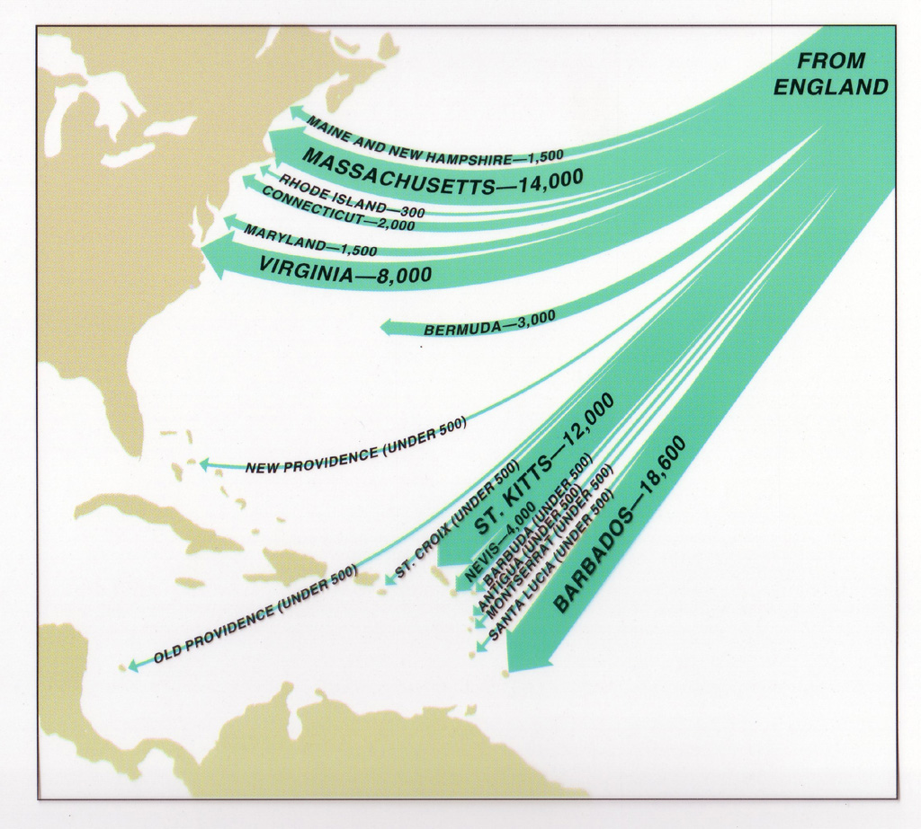
(north of Plymouth)
Great Migration
Notes:
1620-1643-puritans fleeing England-about 80,000---mostly under Charles I---mostly family groups—mostly going to Plymouth

Slide 7
English Colonists in New England
1st: Plymouth colony
Mayflower
Separatists Puritans=> Pilgrims
Mayflower Compact
Civil body politik
2nd Massachusetts Bay
Notes:
Plymouth started in 1620---the two colonies merged in 1691

Slide 8
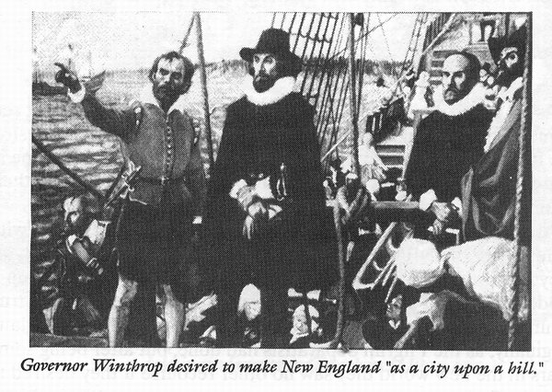

Slide 9
“The New England Way”
Congregationalism
“Saints”
Conversion relation
Views on idleness
Notes:
Given by John Cotton
Congregationalist-church governance based on the local congregation
“saints” those selected to be saved-also called the “elect”-have to make a public declaration of commitment to the congregation and Puritanism
Causes problem in the future as fewer and fewer people make the declaration-

Slide 10
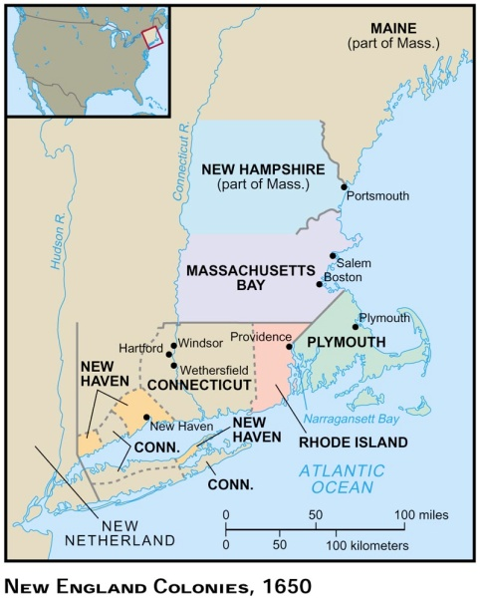
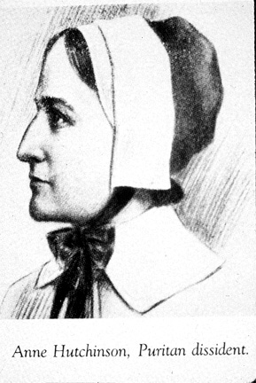
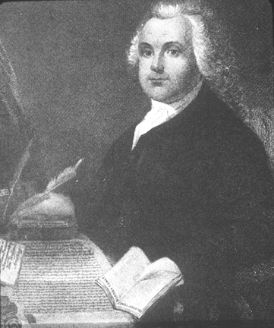
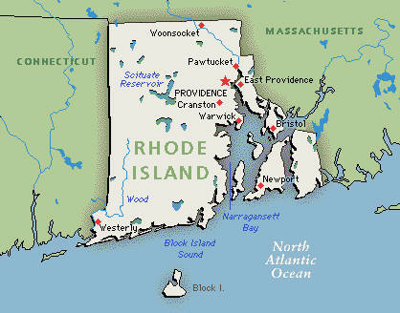
Separation of church and state
Notes:
Promotes seperation of church and state feeling that any state/government would force a particular religion “forced worship stinks in the nostrils of God”

Slide 11
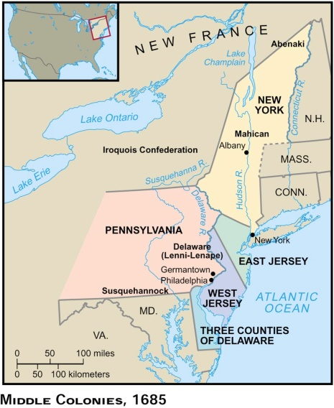
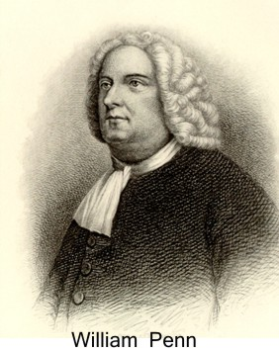
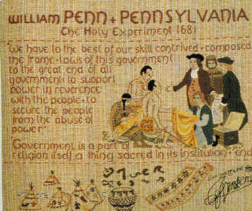

Slide 12
Other Europeans in Middle Colonies
Germans
Go mostly to Pennsylvania
No loyalty to the British and kept their German customs
Scots Irish
Paxton boys-march on Philadelphia protesting Quaker oligarchy

Slide 13
English Colonists in the South
Jamestown: How created?
Headright system
Encouraged new settlers
50 acres

Slide 14
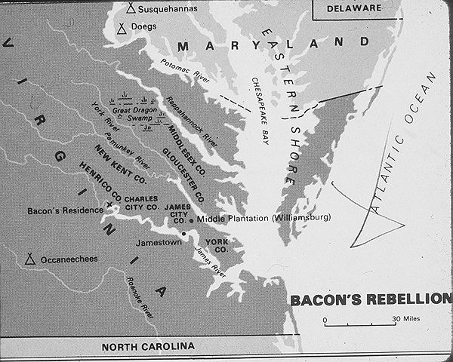
Bacon’s Rebellion

Slide 15
Bacon’s Rebellion
http://www.youtube.com/watch?v=mYsTpYfAeZU
Oh…its awesome.
Be able to summarize the rebellion

Slide 16
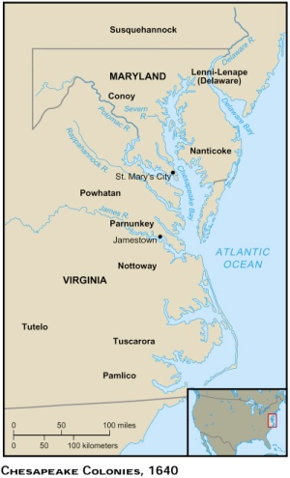
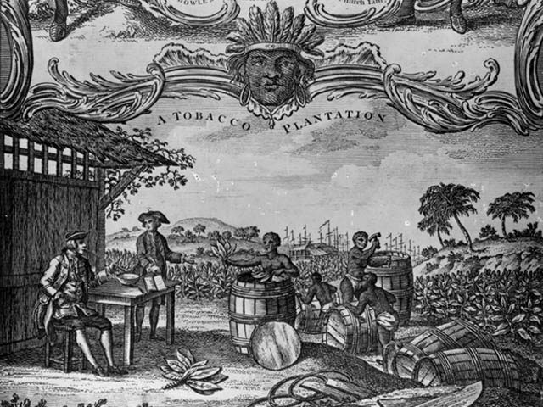

Slide 17
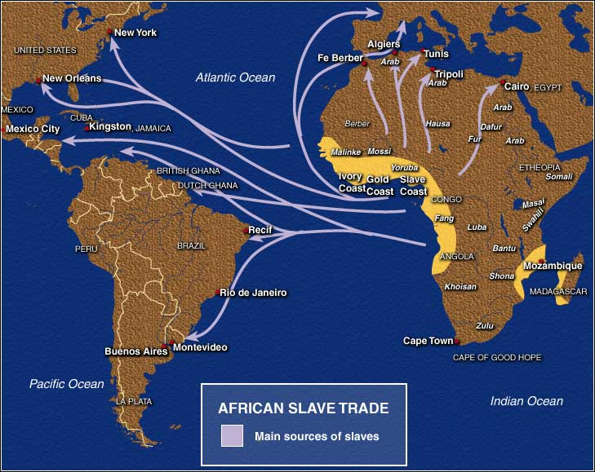

Slide 18
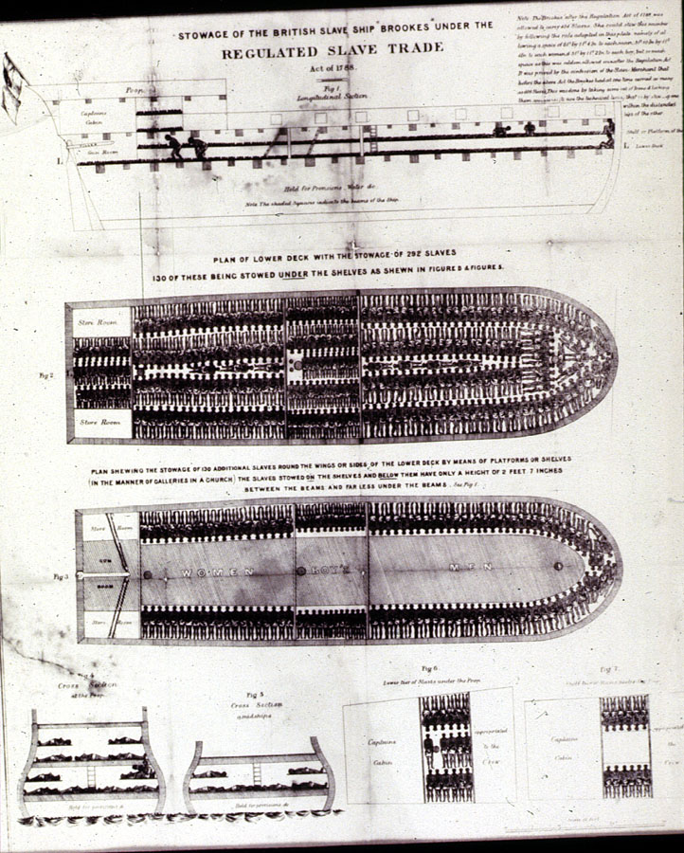
Plan of the British Slave Ship "Brookes," 1789

Slide 19
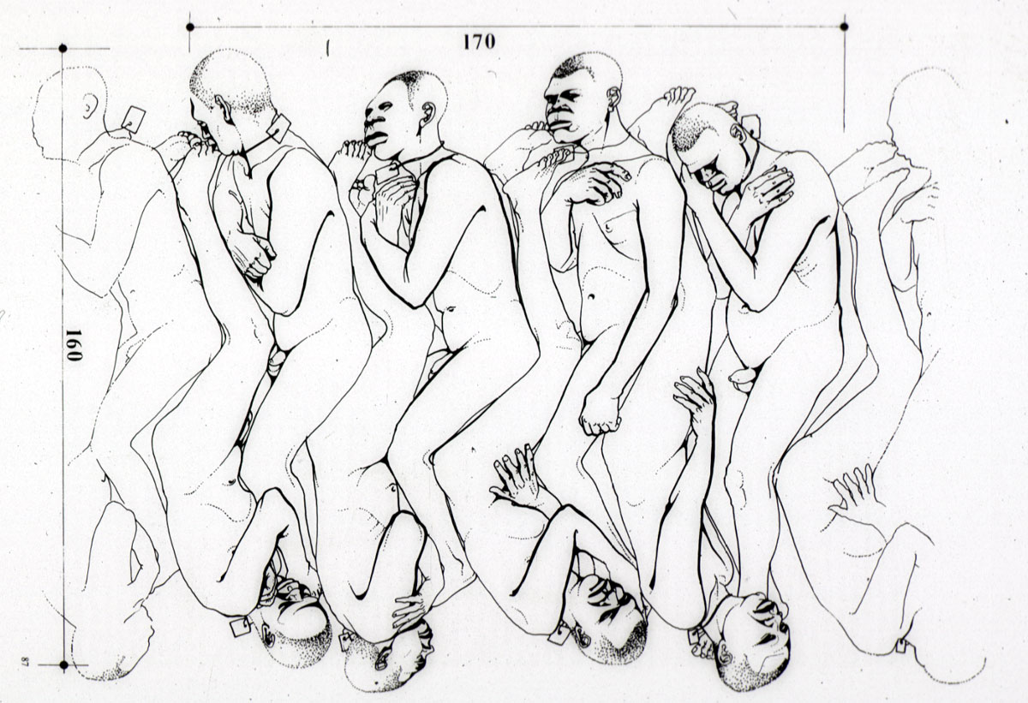
Body Positions of Slaves on the Slave Ship Aurore, 1784

Slide 20
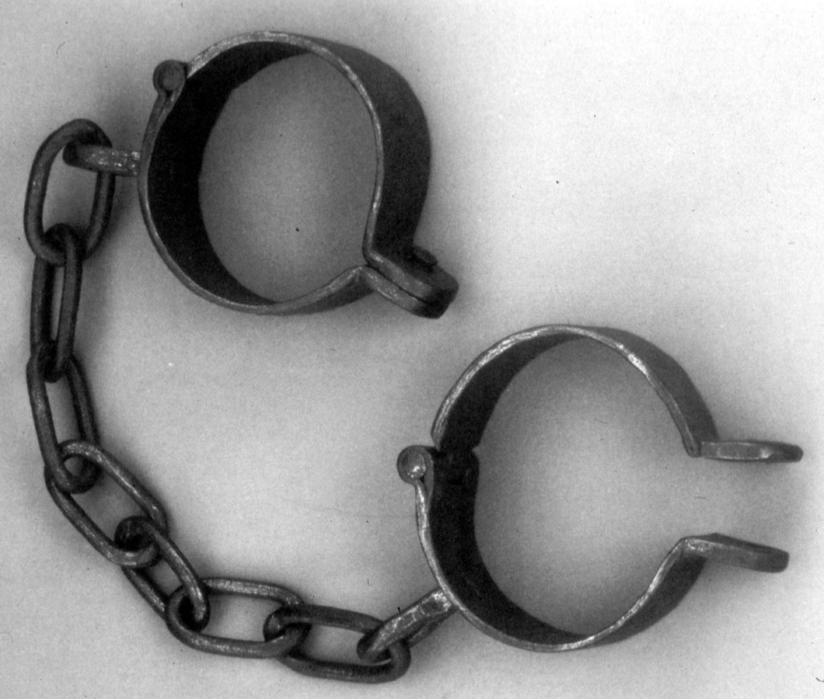
Iron Shackles Used in Slave Trade

Slide 21
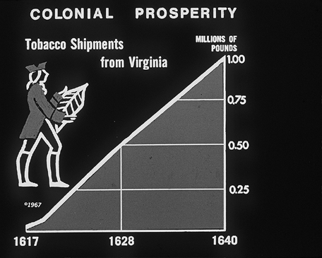

Slide 22
1660
[…]
Slavery
Recognized
regulated

Slide 23
1660
# slaves
# indentured servants

Slide 24
1660
# slaves
Lifelong
Inheritable
Race-based

Slide 25
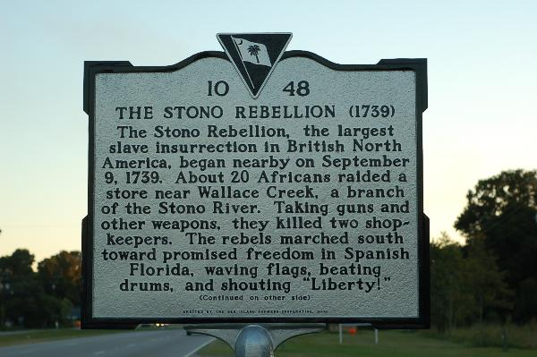
Notes:
Slave rebellion in South Carolina-Jemmy (Cato)killed about 22-25 whites on their way down to Spanish Florida-South Carolina passes the Negro Act of 1740 in order to restric slave assembly, education, and movement

Slide 26
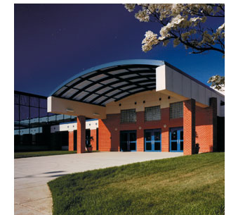
Education
New England
Massachusetts Education laws of 1647
Middle Colonies
Southern Colonies
Notes:
Massachusetts law of 1647-any town of over 50 families must require a primary schools for boys
Middle/Southern-widely varied-most education was in the home

Slide 27
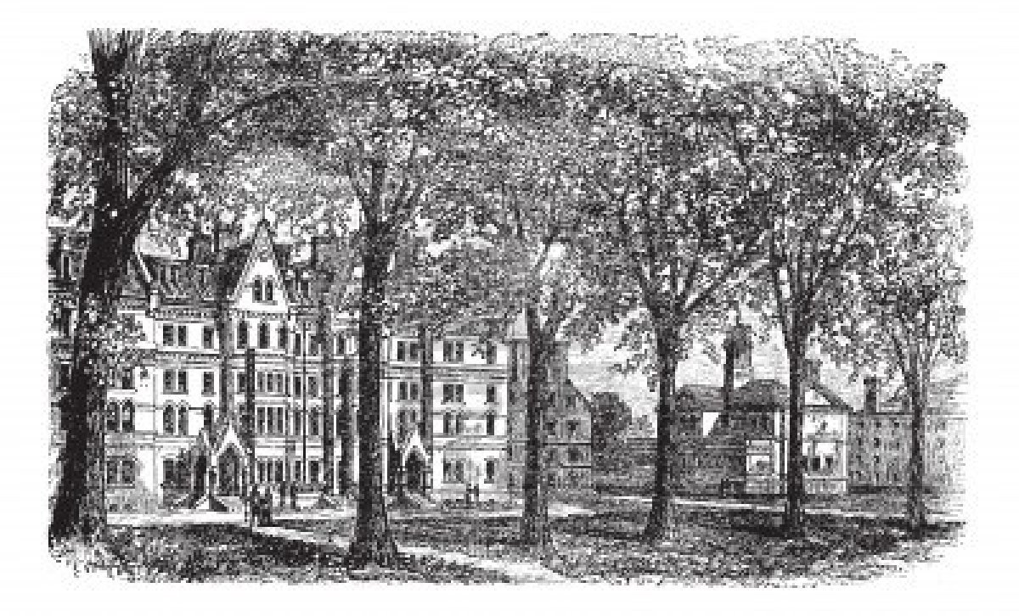
Higher Education
Harvard College in 1636
William and Mary in 1694
Yale in 1701

Slide 28
Social Structure
New England
Family nucleus
New England way of life
South
Microcosm of England
Notes:
New England---family is the center of life---believed you must work hard to succeed ---”idle hands are the devils play things”
South---microsom in that its definitely a land based gentry---those with property held the power

Slide 29
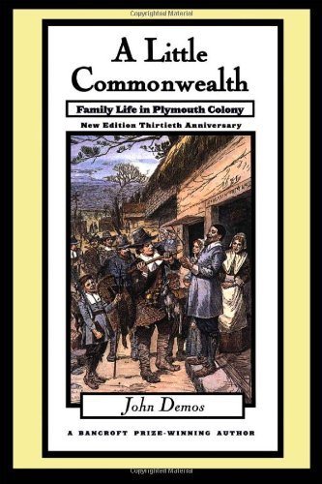
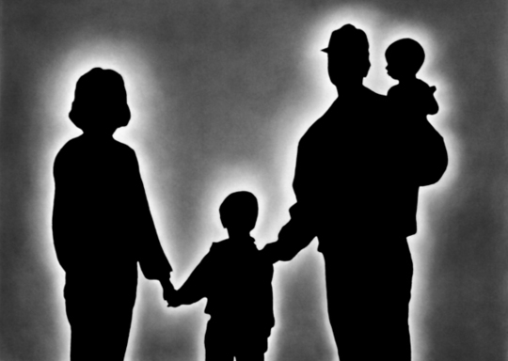
Notes:
Modern novel about social structure in Plymouth---very patriarchical---describes the relationship between husband and wife, parents and children, and master and servant

Slide 30
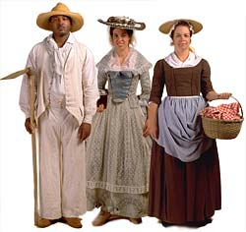
South-Social Hierarchy
Land aristocracy at the top
No real middle class
No real cities

Slide 31
Great Awakening
http://www.youtube.com/watch?v=DJRfRUxqZmo
Who are the leaders?
What is it?
Why is it important?
When does it occur?

Slide 32
Politics and press
Zenger trial
1734-1735
NY
Fought against royal governor
Freedom of the press
Notes:
John Peter Zenger---describes the corruption and inequality the royal governors has in NY-----he’s found not-guilty and becomes the basis for our first amendment right

